Slide 1
RZ CIP TEAM
April, 2022 My Tran

Slide 2
Linux device driver
Description: This document describe how to create a basic Linux device driver.
My Tran
Software Engineering
RZ Team

Slide 3

1. OVERVIEW
Linux supports dynamic insertion and removal of code from the kernel while the system is up and running. The code what we add and remove at run time is called a kernel module
Once the LKM is loaded into the Linux kernel, you can start using new features and functionalities exposed by the kernel module without even restarting the device.
LKM dynamically extends the functionality of the kernel by introducing new features to the kernel such as security, device drivers, file system drivers, system calls etc. (modular approach )
Example: when a hot-pluggable new device is inserted the device driver which is an LKM gets loaded automatically to the kernel

Slide 4
1. STATIC AND DYNAMIC LINUX KERNEL MODULE
Static(y):
When you build a Linux kernel, you can make your module statically linked to the kernel image (module becomes part of the final Linux kernel image ). This method increases the size of the final Linux kernel image. Since the module is ‘built-in’ into the Linux kernel image, you can not ‘unload’ the module. It occupies the memory permanently during run time
Dynamic(m):
When you build a Linux kernel, these modules are NOT built into the final kernel image, and rather there are compiled and linked separately to produce .ko files. You can dynamically load and unload these modules from the kernel using user space programs such as insmod, modprobe , rmmod
In this document we will focus on dynamic kernel module

Slide 5
1. USER SPACE AND KERNEL SPACE
Kernel space: the kernel can access the whole system memory, since it runs with the highest priority on the system. In kernel mode, the CPU can access the whole memory (both kernel space and user space).
User space: This is a set of addresses (locations) where normal programs (such as gedit and so on) are restricted to run.

Slide 6
1. USER SPACE AND KERNEL SPACE
CPU
USER SPACE
KERNEL SPACE
Restricted mode (User level programs)
Privileged mode - kernel level code (driver, scheduler…)

Slide 7
1. USER SPACE AND KERNEL SPACE
The only way for a user app to run in the kernel space is through system calls. Examples of these are read, write, open, close, mmap, and so on.
User space code runs with a lower priority. When a process performs a system call, a software interrupt is sent to the kernel, which turns on privileged mode so that the process can run in kernel space

Slide 8
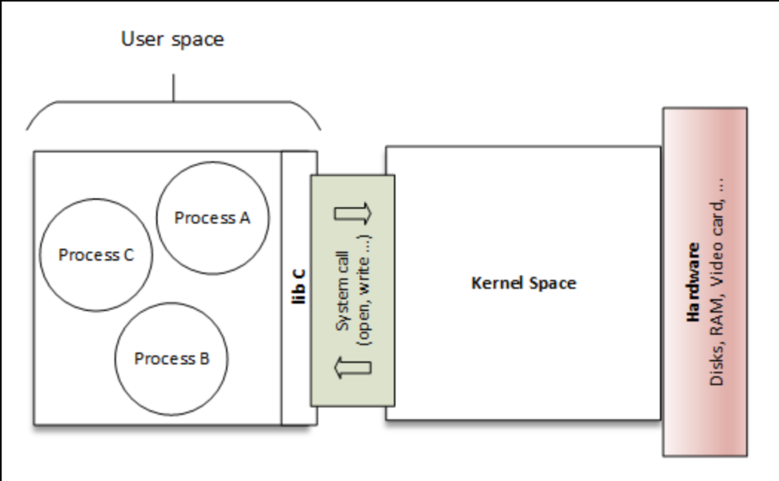
1. USER SPACE AND KERNEL SPACE

Slide 9
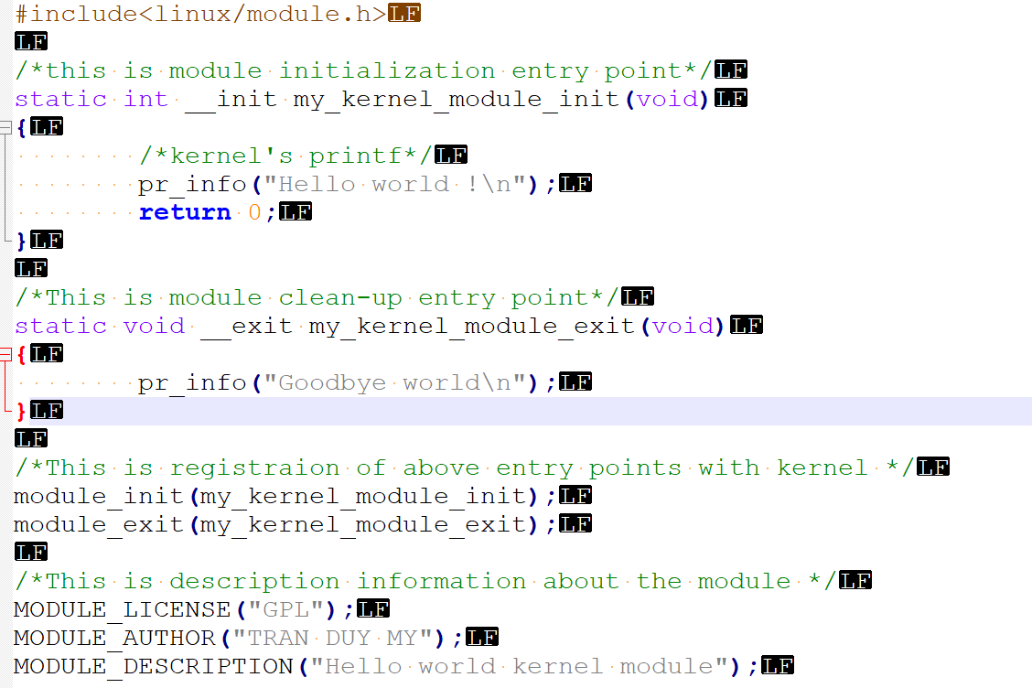
2. FIRST KERNEL MODULE
Header section
Your code
Registration
Module description

Slide 10
KERNEL HEADER AND USER SPACE HEADER
• Since you write a kernel module that is going to be executed in kernel space, you should be using kernel headers, never include any userspace library headers like C std library header files.
• No user space library is linked to the kernel module
• Most of the relevant kernel headers live in linux_source_base/include/linux/

Slide 11
MODULE INITIALIZATION
Prototype: int fun_name(void); • Must return a value ; 0 for success, nonzero means module initialization failed. So the module will not get loaded in the kernel. • This is an entry point to your module ( like main). This function will get called during boot time in the case of static modules • In the case of dynamic modules, this function will get called during module insertion • There should be one module initialization entry point in the module • Initialization of device private data structures • Requesting memory dynamically for various kernel data structures and services • Request for allocation of major-minor numbers • Device file creation

Slide 12
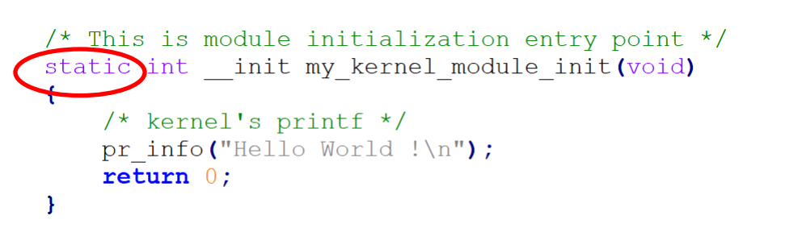
NOTE *
The module initialization function is module-specific and should never be called from other modules of the kernel. It should not provide any services or functionalities which may be requested by other modules.

Slide 13
MODULE CLEAN UP FUNCTION
Prototype void fun_name(void); This is an entry point when the module is removed
If you write a static module, there is no need to implement this function.
Even if your static module has a clean-up function, the kernel build system will remove it during the build process if there is an __exit marker.
Typically, you must do exact reverse operation what you had done in the module init function. undoing init function.
Free memory which are requested in init function
De-init the devices or leave the device in the proper state

Slide 14
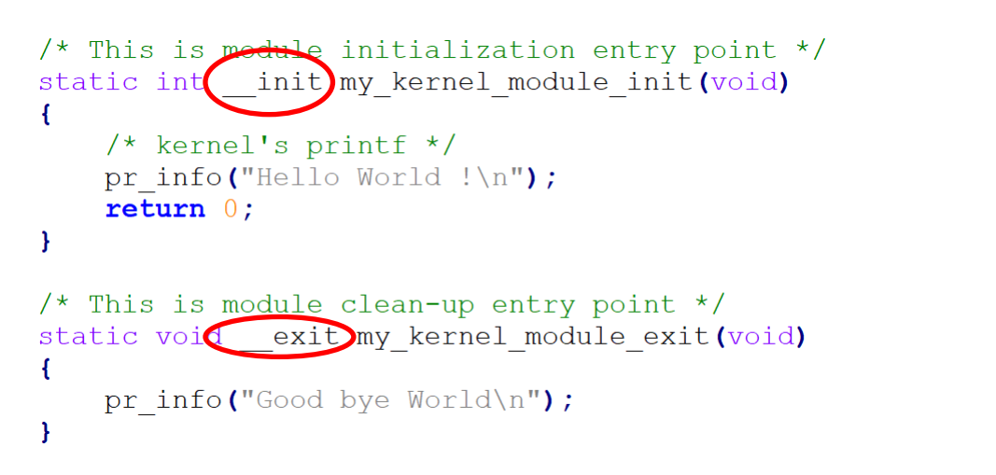
NOTE *

Slide 15
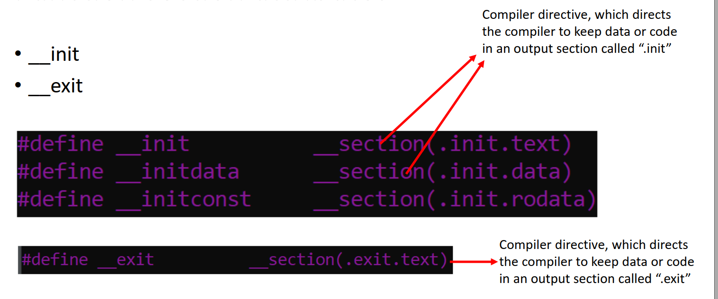

Slide 16
__init
The __init macro defines an init.text section for code. Similarly, any data declared with the __initdata attribute goes into an init.data section. The whole point here is the code and data in the init function is used exactly once during initialization. Once it's invoked, it will never be called again; so, once called, it is then freed up

Slide 17
__exit
Once the cleanup function is called, all the memory is freed. If the code is a part of the static kernel image this macro would have no effect

Slide 18
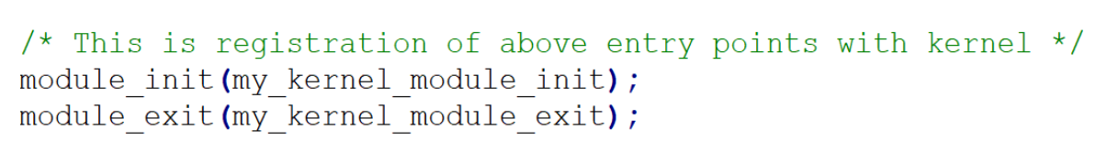
MODULE ENTRY POINT REGISTRATION
The module_[init|exit]() code is macros specifying the entry and exit points. The parameter to each is a function pointer. With modern C compilers, we can just specify the name of the function.
You can almost think of these entry and exit points as a constructor/destructor for a kernel module.

Slide 19
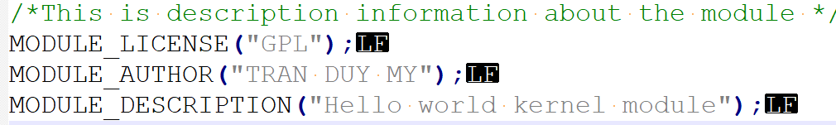
MODULE INFORMATION
MODULE_LICENSE is a macro used by the kernel module to announce its license type .The declared module license is also used to decide whether a given module can have access to the small number of "GPL-only" symbols in the kernel.
MODULE_INFO : You can see the module information by running the below command on the .ko file arm-linux-gnueabihf-objdump -d -j .modinfo <module_name>.ko
MODULE_DESCRIPTION: Description about kernel module

Slide 20
DEBUG WITH PRINTK
When you work in kernel space, you will not have any access to the C standard library to access functions like printf or scanf.
Kernel has its own printf like kernel API called printk, where the letter ‘k’ signifies kernel space printing.
Example:
printf(“Hello this is user application running \n”);
printk(“Hello this is kernel code running \n”);
printf(“ value of data1 = %d data = %d\n” , d1,d2);
printk(“ value of data1 = %d data = %d\n” , d1,d2);

Slide 21
DEBUG WITH PRINTK
When using printk , the message will go into the kernel ring buffer simply we call “Kernel log,” and we can print and control the kernel ring buffer using the command dmesg
The printk does not support floating-point formats (%e, %f, %g )

Slide 22
BUILDING KERNEL MODULE
Kernel module can be built in 2 ways
• Statically linked against the kernel image
• Dynamically loadable.
dynamically loadable kernel module
In tree module (internal to the linux kernel tree)
Out of tree module (external to the linux kernel tree)
In this document, we just focus on Out of tree module

Slide 23
BUILDING KERNEL MODULE (OUT OF TREE)
The command to build an external module is:
make –C <path to linux kernel tree> M= <path of module> [target]
You have to trigger the top level makefile of the Linux kernel source tree. We use –C option to switch the make. When you execute make –C, the make first enters into the Linux kernel source tree and execute top level makefile.
We direct top level makefile to our local folder by using the variable M

Slide 24
BUILDING KERNEL MODULE (OUT OF TREE)
Linux kernel source tree
Top level Makefile
Local Makefile
Your working directory where external modules to be compiled are stored

Slide 25
COMMAND SYNTAX
make -C $KDIR M=$PWD [Targets]
-C $KDIR: The directory where the kernel source is located. "make" will actually change to the specified directory when executing and will change back when finished
M=$PWD: Informs kbuild that an external module is being built. The value given to "M" is the absolute path of the directory where the external module (kbuild file) is located.
[Targets]:
modules :The default target for external modules. It has the same functionality as if no target was specified.
modules_install: Install the external module(s). The default location is /lib/modules//extra/, but a prefix may be added with INSTALL_MOD_PATH
clean : Remove all generated files in the module directory only

Slide 26
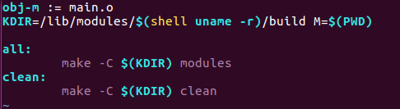
CREATE LOCAL MAKEFILE
Creating a local makefile in your work directory with following syntax:
obj-<X> := <module_name>.o Here obj-<X> is kbuild variable and ‘X’ takes one of the below values X = n , Do not compile the module X= y, Compile the module and link with kernel image X = m , Compile as dynamically loadable kernel module

Slide 27
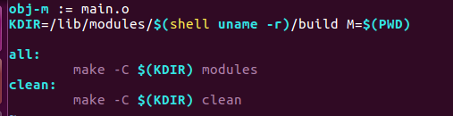
CREATE LOCAL MAKEFILE
obj-m := main.o The kbuild system will build main.o from main.c and after linking, will result in the kernel module main.ko

Slide 28
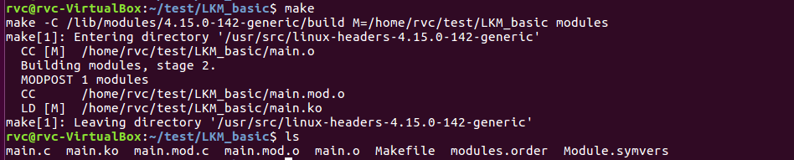
BUILDING KERNEL MODULE
Type make or make all to build main.ko kernel module

Slide 29
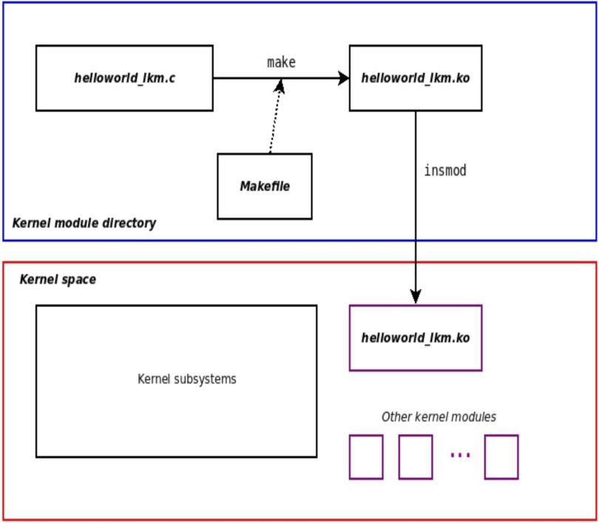
INSERT AND REMOVE MODULE

Slide 30
INSERT AND REMOVE MODULE
Module utility:
sudo insmod <module_path>.ko : Tries to load the given module. The full path to the module object file must be given.
lsmod : Displays the list of loaded modules
sudo rmmod <module_name> : Tries to remove the given module.Will only be allowed if the module is no longer in use (for example, no more processes opening a device file)

Slide 31
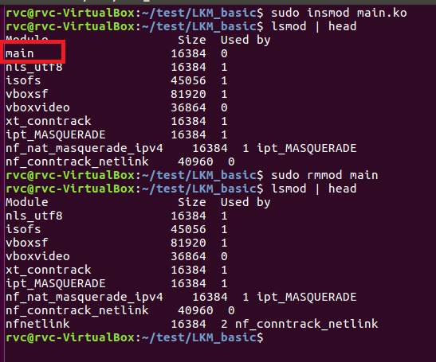
INSERT AND REMOVE MODULE

Slide 32
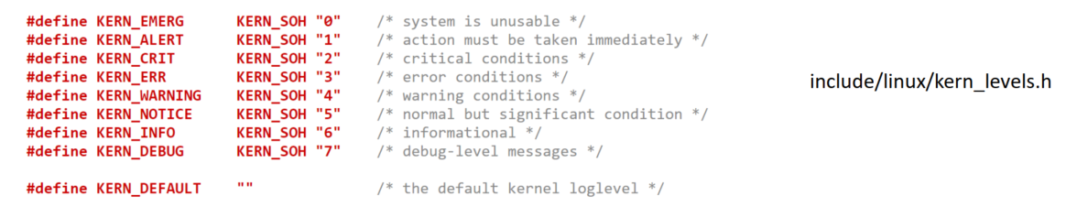
KERNEL LOG LEVEL
Based on the kernel log level you can control the priority of your printk messages. There are 8 such log levels. A lower number indicates a higher priority. And the default printk log level or priority is usually set to 4. i.e., KERN_WARNING
The log level will be used by the kernel to understand the priority of the message . Based on the priority kernel decides whether the message should be presented to the user immediately, by printing directly on to the console.

Slide 33
PRINTK WRAPPERS
Name | Log level | Alias function
KERN_EMERG | “0” | pr_emerg
KERN_ALERT | “1” | pr_alert
KERN_CRIT | “2” | pr_crit
KERN_ERR | “3” | pr_err
KERN_WARNING | “4” | pr_warning
KERN_NOTICE | “5” | pr_notice
KERN_INFO | “6” | pr_info
KERN_DEBUG | “7” | pr_debug (works only if DEBUG is defined)
printk(KERN_INFO “Hello this is jut for your information\n”); <=> pr_info(“Hello this is jut for your information\n”);

Slide 34
LINUX DEVICE DRIVER
A device driver is a piece of code that configures and manages a device
When the device driver code is loaded into Linux operating system, it exposes interfaces to the user-space so that the user application can communicate with the device.

Slide 35
LINUX DEVICE DRIVER
Application
User level programs
USER SPACE
/dev/abc
Device files
Device driver of “abc” device
KERNEL SPACE
Device driver
abc
HARDWARE
Device

Slide 36
TYPE OF DEVICES
Under Linux, there are essentially three types of devices:
Network devices. They are represented as network interfaces, visible in user space using ip a
Block devices. They are used to provide user space applications access to raw storage devices (hard disks, USB keys). They are visible to the applications as device files in /dev.
Character devices. They are used to provide user space applications access to all other types of devices (input, sound, graphics, serial, etc.). They are also visible to the applications as device files in /dev.
Most devices are character devices, so we will study these in more details.

Slide 37
CHARACTER DRIVER
Character driver accesses data from the device sequentially byte by byte (like a stream of characters) not as a chunk of data
Char devices: sensors, RTC, keyboard, serial port, parallel port, etc

Slide 38
DEVICE NUMBER (MAJOR AND MINOR)
Within the kernel, all block and character devices are identified using a major and a minor number.
The major number typically indicates the family of the device.
The minor number allows drivers to distinguish the various devices they manage.
Most major and minor numbers are statically allocated, and identical across all Linux systems.

Slide 39
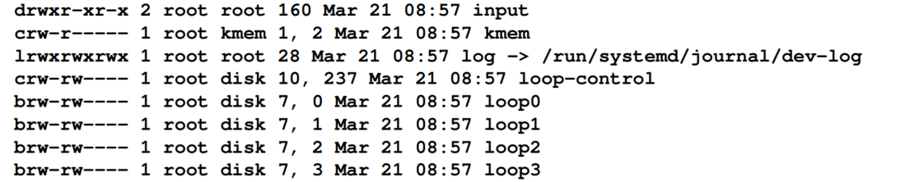
DEVICE NUMBER (MAJOR AND MINOR)
The first character of the first column identifies the file type. Possible values are:
c: This is for character device files
b: This is for block device file
l: This is for symbolic link
d: This is for directory
s: This is for socket
p: This is for named pipe

Slide 40
DEVICE NUMBER (MAJOR AND MINOR)
The fifth and sixth columns right before the date are major and minor number
The kernel holds the numbers that identify a device in dev_t type variables, which are simply u32 (32-bit unsigned long). The major is represented with only 12 bits, whereas the minor is coded on the 20 remaining bits.

Slide 41
DEVICE FILE
A very important UNIX design decision was to represent most system objects as files
It allows applications to manipulate all system objects with the normal file API (open, read, write, close, etc.)
So, devices had to be represented as files to the applications
All device files are by convention stored in the /dev directory

Slide 42
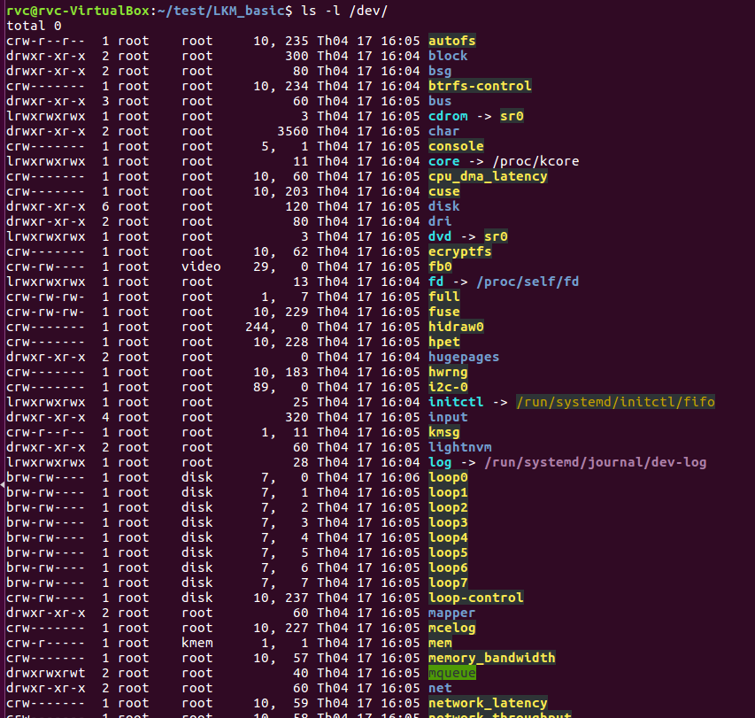
DEVICE FILE

Slide 43
KERNEL API AND UTILITIES
Kernel functions and data structures | Kernel header files
alloc_chrdev_region() unregister_chrdev_region() | include/linux/fs.h
cdev_init() cdev_add() cdev_del() | Include/linux/cdev.h
device_create() class_create() device_destroy( class_destroy() | Include/linux/device.h
copy_to_user() copy_from_user() | Include/linux/uaccess.h

Slide 44
KERNEL API AND UTILITIES
CREATION | DELETION
alloc_chrdev_region(); | unregister_chrdev_region();
cdev_init(); | cdev_del();
cdev_add();
class_create(); | class_destroy();
device_create(); | device_destroy();

Slide 45
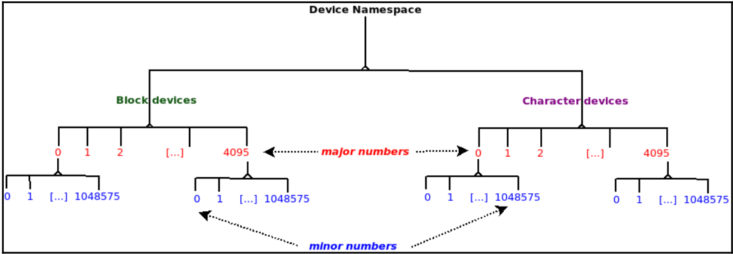
DYNAMICALLY REGISTER A RANGE OF CHARACTER DEVICE NUMBERS
Prototype:
int alloc_chrdev_region(dev_t *dev, unsigned base_minor, unsigned count, const char *name)
dev_t * dev : output parameter for first assigned number
unsigned baseminor: first of the requested range of minor numbers
unsigned count: the number of minor numbers required
const char * name : the name of the associated device or driver

Slide 46
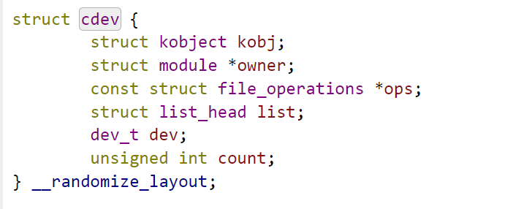
INITIALIZE A CDEV STRUCTURE
Prototype:
void cdev_init (struct cdev * cdev, const struct file_operations * fops);
struct cdev * cdev: the structure to initialize
const struct file_operations * fops : the file_operations for this device
Pointer to the module that own the this structure. It usually initialized THIS_MODULE
Cdev structure
Pointer to file operation structure of the driver

Slide 47
INITIALIZE A CDEV STRUCTURE
Prototype:
int cdev_add (struct cdev * p, dev_t dev, unsigned count);
struct cdev * p: the cdev structure for the device
dev_t dev : the first device number for which this device is responsible
unsigned count : the number of consecutive minor numbers corresponding to this device

Slide 48
DYNAMIC CREATE DEVICE FILE IN LINUX
In Linux, you can create a device file dynamically(on demand), you dont have to manually create the device files under /dev directory to access your hardware.
User-level program such as udevd can populate /dev directory with device files dynamically
udev program listens to the uevents generated by hot plug events or kernel modules. When udev receives the uevents, it scans the subdirectories of /sys/class looking for the ‘dev’ files to create device files
For each such 'dev' file, which represents a combination of major and minor number for a device, the udev program creates a corresponding device file in /dev directory

Slide 49
class_create
class_create:
Create a directory in sysfs : /sys/class/<your_class_name>
Prototype: struct class * class_create (struct module * owner, const char * name);
Create a directory in sysfs : /sys/class/<your_class_name>
Owner: pointer to the module that is to “own” this struct class
Name: pointer to a string for the name of this class.

Slide 50
device_create
This function creates a subdirectory under /sys/class/<your_class_name> with your device name.
This function also populates sysfs entry with dev file which consists of the major and minor numbers, separated by a : character
Prototype: struct device * device_create(struct class * class, struct device * parent, dev_t devt, void * drvdata, const char * fmt, ...);
Class: pointer to the struct class that this device should be registered to
Parent: pointer to the parent struct device of this new device, if any
Devt: the dev_t for the char device to be added
Drvdata: the data to be added to the device for callbacks
Fmt : string for the device's name

Slide 51
/sys/class/”you_class_name”/”your device”/dev
/dev/”your_device”
Udev scan device folder in /sys/class and looking for “dev” file to create device file in /dev
4
/sys/class/”you_class_name”
udev
USER SPACE
1
2
3
KERNEL SPACE
Trigger uevents
class_create
device_create
Hot plug or remove

Slide 52
FILE OPERATIONS
Operations that you can perform on files depend on the drivers that manage those files. Such operations are defined in the kernel as instances of struct file_operations.
The structure exposes a set of callbacks that will handle any user space system call on a file.
For example, if you want users to be able to perform a write operation on your device files, you must implement a write callback function and add it into the struct file_operations that will be tied to your device.

Slide 53
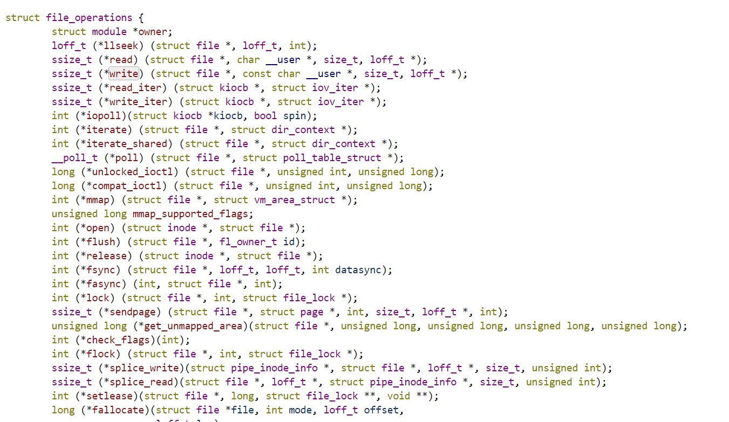
FILE OPERATIONS
You can see what operations are supported in file_operations structure that is located in linux/include/linux/fs.h kernel header file:

Slide 54
FILE OPERATIONS
Each of these callbacks is linked with a system call.
When a user code calls a file-related system call on a given file, the kernel looks for the driver responsible for that file, locates its struct file_operations structure, and checks whether the method that matches the system call is defined or not. If yes, it simply runs it. If not, it returns an error code that varies depending on the system call.
For example, an undefined (*mmap) method will return -ENODEV to user, whereas an undefined (*write) method will return –EINVAL.

Slide 55
FILE OPERATIONS
In this document we will create a basic character device driver that support 4 operations open, release, read, write.

Slide 56
VIRTUAL FILE SYSTEM (VFS)
The Virtual File System (also known as the Virtual Filesystem Switch) is the software layer in the kernel that provides the filesystem interface to userspace programs. It also provides an abstraction within the kernel which allows different filesystem implementations to coexist.

Slide 57
INODE OBJECT
Unix makes distinguish between the contents of a file and the information about a file
An inode is a VFS data structure(struct inode) that holds general information about a file.
Inode contains all the information needed by the filesystem to handle a file.
Each file has its own inode object, which the filesystem uses to identify the file
Each inode object is associated with an inode number, which uniquely identifies the file within the filesystem.
The inode object is created and stored in memory as and when a new file (regular or device ) gets created

Slide 58
FILE OBJECT
Whenever a file is opened a file object is created in the kernel space .
There will one file object for every open of a regular or device file.
Stores information about the interaction between an open file and a process
This information exists only in kernel memory during the period when a process has the file open. The contents of file object is NOT written back to disks unlike inode.

Slide 59
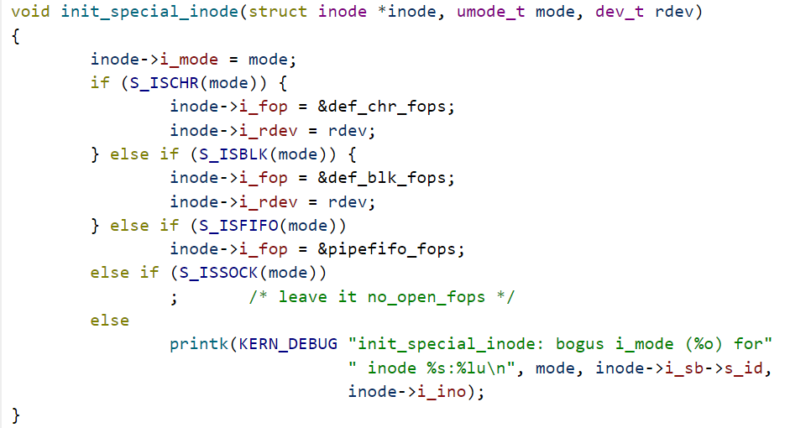
INODE OBJECT OF DEVICE FILE
When a device file is created, init_special_inode() function get called.
The function is located at linux/fs/inode.c file

Slide 60
INODE OBJECT OF DEVICE FILE
“mode” is type of special files, we can see there are many diference special files such as character, block ,fifo, socket with the corresponding condition check macro S_ISCHR, S_ISBLK, S_ISFIFO, S_ISSOCK
“r_dev” is device number
Inode->f_ops is initialized by corresponding default files operations &def_chr_fops

Slide 61
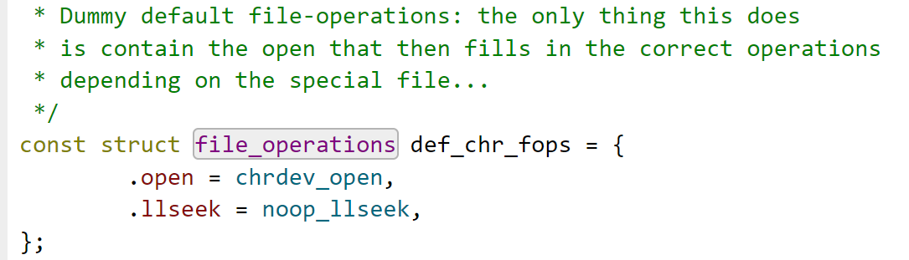
DEVICE FILE INODE OBJECT
The default character file operations is defined at linux/fs/char_dev.c

Slide 62
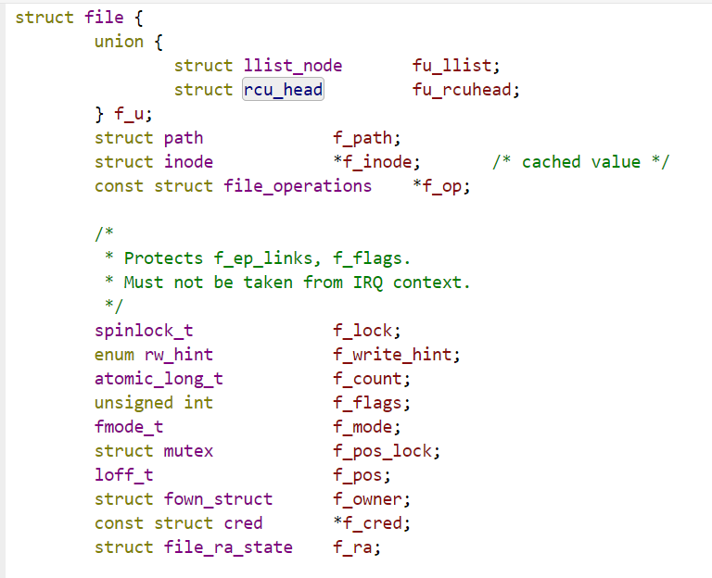
FILE OBJECT
The struct file have f_op pointer that is connected to the operations of the driver
The structure is located in linux/include/linux/fs.h

Slide 63
open, read, write, release
device file
USER SPACE
KERNEL SPACE
INODE OBJECT
FILE OBJECT
struct cdev *i_cdev;
const struct file_operations *f_op;
open
read
write
release
const struct file_operations *ops;
YOUR DRIVER
CDEV STRUCTURE

Slide 64
OPEN METHOD
Prototype: int (*open) (struct inode *, struct file *);
Struct Inode* : Pointer of inode that associated with file name
Struct file * : Pointer of file object
Return value:
0 if open is successfully
Negative error code if open fails

Slide 65
OPEN METHOD
Initialize the device or make device respond for read/write access
Detect device initialization errors
Check open permission (O_RDONLY, O_WRONLY, O_RDWR)
Identify the device being opened using minor number
Prepare device private data structure if required
Update f_pos if required
Open method is optional. If not provided , open will always succeed and driver is not notified

Slide 66
RELEASE METHOD
Prototype: int (*open) (struct inode *, struct file *);
Struct Inode* : Pointer of inode that associated with file name
Struct file * : Pointer of file object
Return value:
0 if open is successfully
Negative error code if open fails

Slide 67
RELEASE METHOD
In release method the driver can do reverse operation of what open had done.
E.g. if open method brings the device out of low power mode, then release method may send the device back to the low power mode.
Basically you should leave the device in its default state, the state which was before the open call.
Free any data structures allocated by the open method
Return 0 on success . Negative error code if any errors
For example you try to de-initialize the device and the device doesn’t respond

Slide 68
OPEN AND RELEASE METHOD DATA FLOWS
fd = open(“/dev/my_device”, O_RDWR)
/dev/my_device
USER SPACE
KERNEL SPACE
VIRTUAL FILE SYSTEM (VFS)
Open a file by create a new file object and linking it into corresponding inode object
Pointer of inode that associated with file name
Pointer of file object

Slide 69
READ METHOD
Prototype: ssize_t (*read) (struct file *filp, char __user *buff, size_t count, loff_t *f_pos);
filp : Pointer of file object
__user: optional macro which alerts the programmer that this is a user level program. It cannot be trusted for direct dereferencing
buff: pointer of user buffer
count: read count given by user
f_pos: pointer of current file position from which the read has to begin

Slide 70
READ METHOD
Read ‘count’ bytes from a device starting at position ‘ f_pos’.
Update the ‘f_pos’ by adding the number bytes successfully read
Return number of bytes successfully read
Return 0 if there is no bytes to read (EOF)
Return appropriate error code (-ve value) if any error
A return value less than ‘count’ does not mean that an error has occurred.

Slide 71
WRITE METHOD
Prototype: ssize_t (*read) (struct file *filp, char __user *buff, size_t count, loff_t *f_pos);
filp : Pointer of file object
buff: pointer of user buffer
count: write count given by user
f_pos: pointer of current file position from which the read has to begin

Slide 72
WRITE METHOD
Write ‘count’ bytes into the device starting at position ‘f_pos’.
Update the ‘f_pos’ by adding the number bytes successfully written
Return number of bytes successfully written
Return appropriate error code (-ve value) if any error

Slide 73
DEVICE MEMORY
0
1
510
511
f_pos
(current file position)

Slide 74
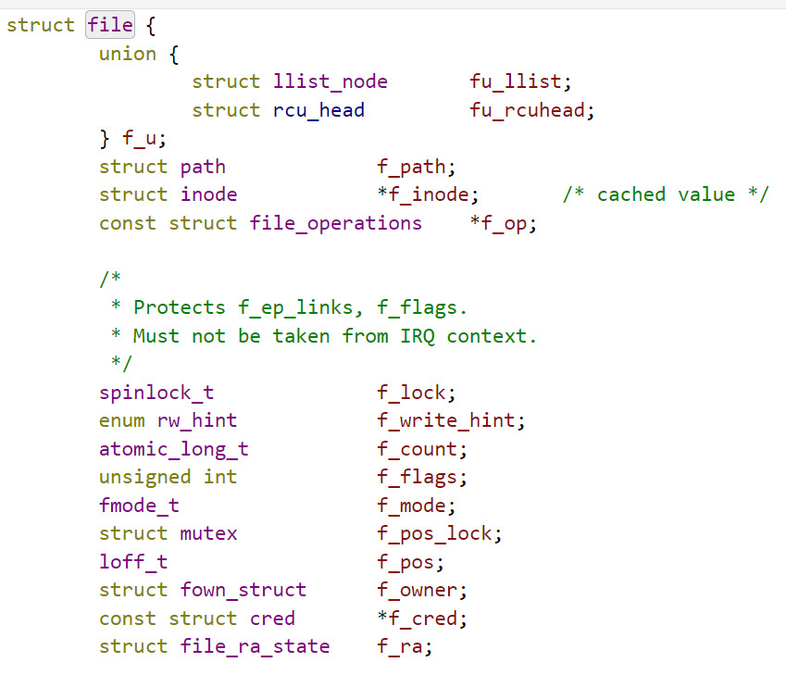
DEVICE MEMORY
The main information stored in a file object is the current file offset—the current position in the file from which the next operation will take place.

Slide 75
DEVICE MEMORY
Example: file position after read 7 byte
0
1
2
3
4
5
6
7
510
511
f_pos
(previous file position)
f_pos
(current file position)

Slide 76
ERROR HANDLING
You can use some kernel macros to deal with return of error pointers by kernel functions.
The below macros help to understand what made kernel function to fail.
IS_ERR()
PTR_ERR()
ERR_PTR()
These macros can be found in include include/linux/err.h

Slide 77
DATA COPY BETWEEN KENEL SPACE AND USER SPACE
API :
copy_to_user()
copy_from_user()
Role of these two functions
Copying data between user space and kernel spaCe
Check whether the user space pointer is valid or not
If the pointer is invalid, no copy is performed.
if an invalid address is encountered during the copy, only part of the data is copied. In both cases, the return value is the amount of memory still to be copied

Slide 78
copy_to_user
Prototype : unsigned long copy_to_user (void __user * to, const void * from, unsigned long n);
to: Destination address, in user space
from: Source address, in kernel space
n: Number of bytes to copy

Slide 79
copy_to_user
Returns 0 on success or number of bytes that could not be copied
If this function returns non zero value , you should assume that there was a problem during data copy.So return appropriate error code (-EFAULT)

Slide 80
copy_from_user
Prototype : unsigned long copy_to_user (void __user * to, const void * from, unsigned long n);
to: Destination address, in kernel space.
from: Source address, in user space.
n: Number of bytes to copy

Slide 81
copy_from_user
Returns 0 on success or number of bytes that could not be copied
If this function returns non zero value , you should assume that there was a problem during data copy. So return appropriate error code (-EFAULT)

Slide 82
Device memory buffer
copy_to_user (read)
Device memory buffer
copy_from_user (write)
Kernel space
User space

Slide 83
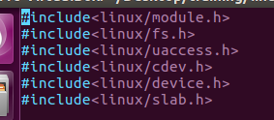
DEMO
Add kernel header

Slide 84
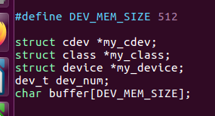
DEMO
Declare global variable

Slide 85
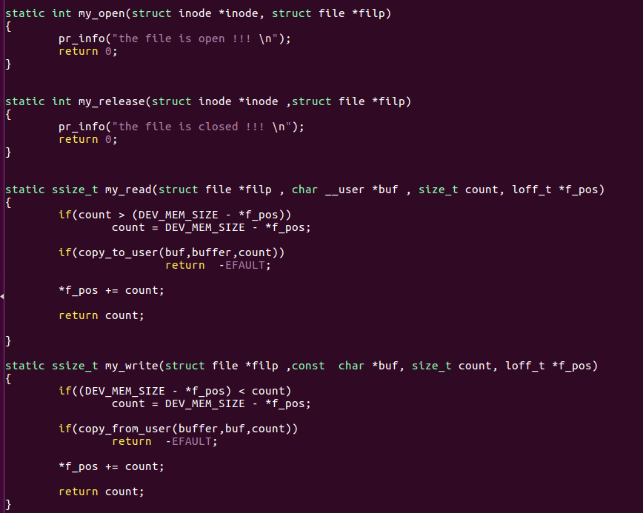
DEMO
Define file operation method

Slide 86
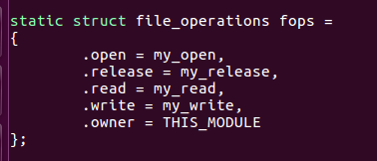
DEMO
Assign driver operation function address to corresponding field

Slide 87
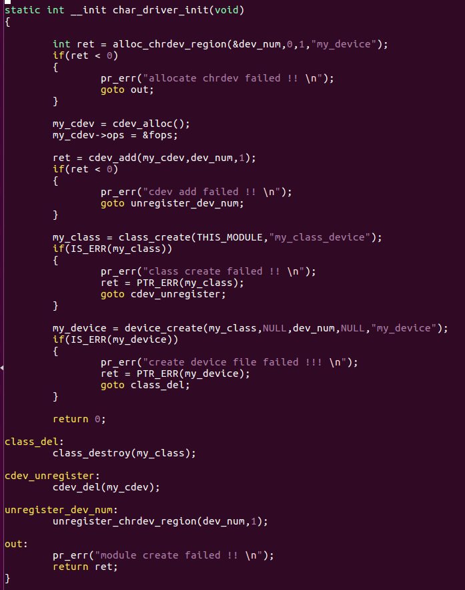
DEMO
Initialize module

Slide 88
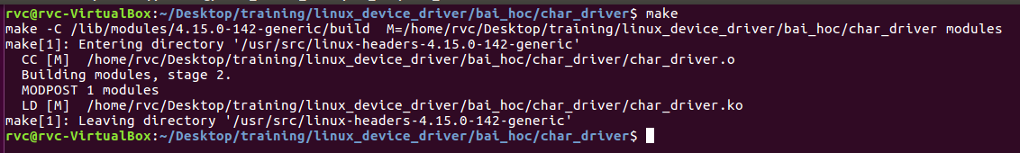
DEMO
Build kernel driver

Slide 89
DEMO
Insert module and check the device file that we are created

Slide 90
DEMO
Try to trigger write and read system call to the device file by echo and cat command.

Slide 91
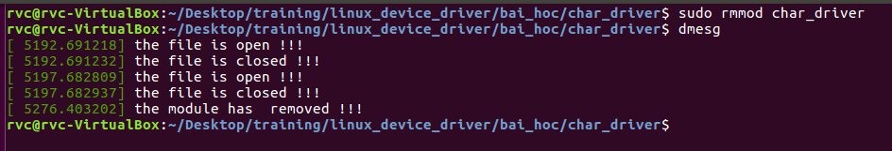
DEMO
All features worked correctly !!!

Slide 92
REFERENCE
[1] Understanding the Linux Kernel, Third Edition by Daniel P. Bovet, Marco Cesati Ph.D
[2] Linux Kernel Development, 3rd Edition A thorough guide to the design and implementation of the Linux kernel by Robert Love
[3] Linux Device Drivers Development Develop customized drivers for embedded Linux by John Madieu
[4] Linux Kernel Programming A comprehensive guide to kernel internals, writing kernel modules, and kernel synchronization by Kaiwan N Billimoria
[5] Linux Kernel Programming Part 2 - Char Device Drivers and Kernel Synchronization by Kaiwan N Billimoria
[6] Linux kernel training course by Bootlin
[7] Linux device driver training course by Kiran Nayak

Slide 93
Thank You For Your Attendance

